Slide 1
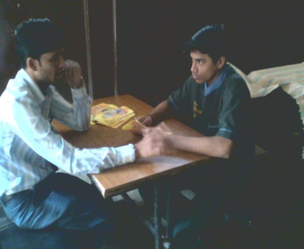
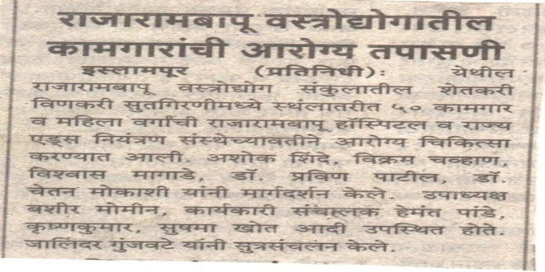
Prakash Shikshan Prasarak Mandal’s
Late Rajarambapu Ayurvedic Medical College, Hospital and Research Center,
Urun Islampur,
Tal.: Walawa Dist.: Sangli.
SR. No. | Date | Social Work | Photocopy of Social Work | Social Work display in Local News Paper time to time
1 | 01.12.2010 | Health camp of workers of sugar factory

Slide 2
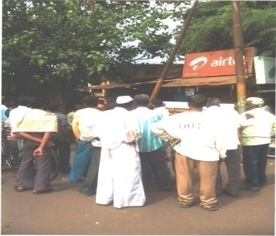
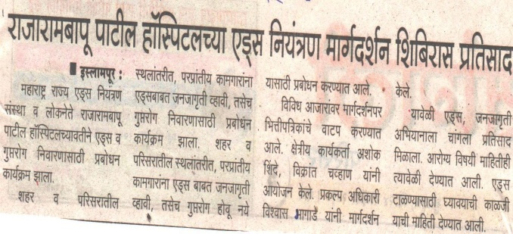
Prakash Shikshan Prasarak Mandal’s
Late Rajarambapu Ayurvedic Medical College, Hospital and Research Center,
Urun Islampur,
Tal.: Walawa Dist.: Sangli.
SR. No. | Date | Social Work | Photocopy of Social Work | Social Work display in Local News Paper time to time
2 | 06.12.2010 | Camp under Maharashtra State Aids Control project

Slide 3
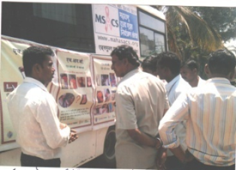
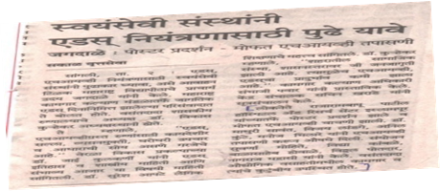
Prakash Shikshan Prasarak Mandal’s
Late Rajarambapu Ayurvedic Medical College, Hospital and Research Center,
Urun Islampur,
Tal.: Walawa Dist.: Sangli.
SR. No. | Date | Social Work | Photocopy of Social Work | Social Work display in Local News Paper time to time
3 | 08.12.2010 | Organize program to create awareness w.r.t. AIDS

Slide 4
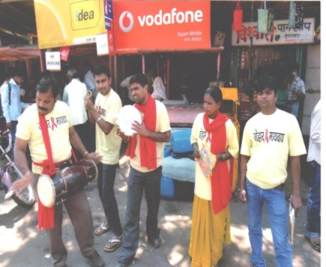
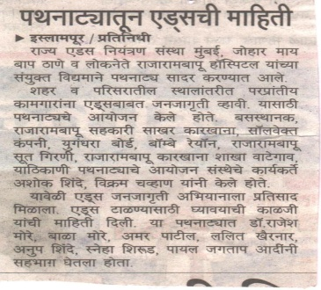
Prakash Shikshan Prasarak Mandal’s
Late Rajarambapu Ayurvedic Medical College, Hospital and Research Center,
Urun Islampur,
Tal.: Walawa Dist.: Sangli.
SR. No. | Date | Social Work | Photocopy of Social Work | Social Work display in Local News Paper time to time
4 | 12.12.2010 | To create Aids awareness activity in society under MSAC

Slide 5
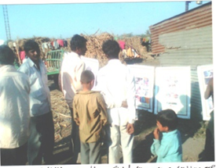
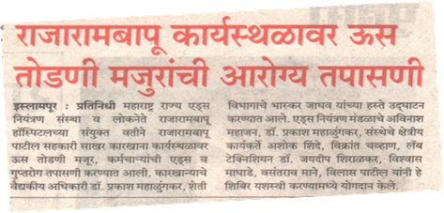
Prakash Shikshan Prasarak Mandal’s
Late Rajarambapu Ayurvedic Medical College, Hospital and Research Center,
Urun Islampur,
Tal.: Walawa Dist.: Sangli.
SR. No. | Date | Social Work | Photocopy of Social Work | Social Work display in Local News Paper time to time
5 | 14.12.2010 | Health camp for sugarcane cutting workers in sugar factory

Slide 6
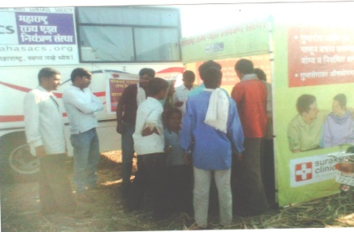
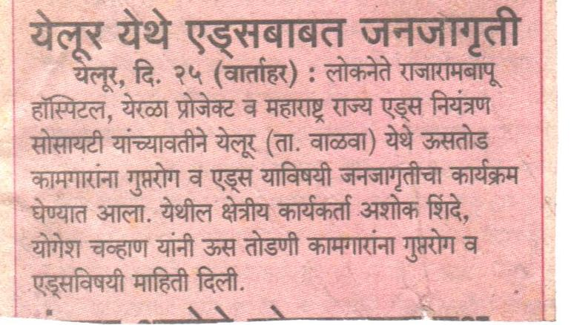
Prakash Shikshan Prasarak Mandal’s
Late Rajarambapu Ayurvedic Medical College, Hospital and Research Center,
Urun Islampur,
Tal.: Walawa Dist.: Sangli.
SR. No. | Date | Social Work | Photocopy of Social Work | Social Work display in Local News Paper time to time
6 | 18.12.2010 | To create Aids awareness activity in society under MSAC

Slide 7
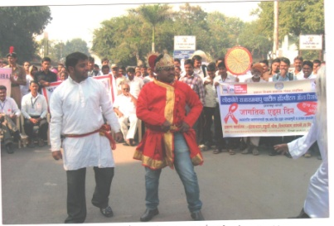
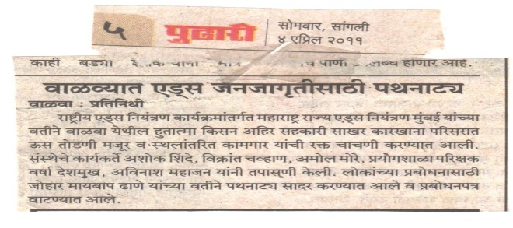
Prakash Shikshan Prasarak Mandal’s
Late Rajarambapu Ayurvedic Medical College, Hospital and Research Center,
Urun Islampur,
Tal.: Walawa Dist.: Sangli.
SR. No. | Date | Social Work | Photocopy of Social Work | Social Work display in Local News Paper time to time
7 | 04/04/2011 | To create Aids awareness activity in society under MSAC

Slide 8
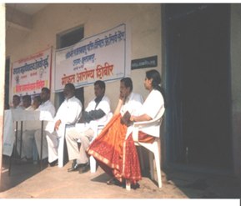
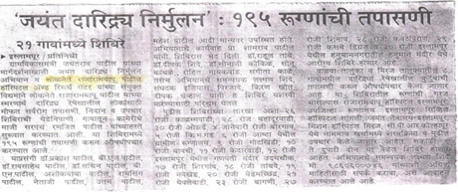
Prakash Shikshan Prasarak Mandal’s
Late Rajarambapu Ayurvedic Medical College, Hospital and Research Center,
Urun Islampur,
Tal.: Walawa Dist.: Sangli.
SR. No. | Date | Social Work | Photocopy of Social Work | Social Work display in Local News Paper time to time
8 | 27.12.2011 | Free Health Camp for Backward Class peoples in 21 Villages

Slide 9
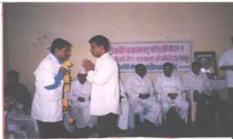
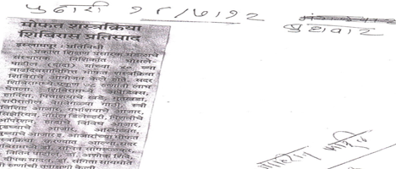
Prakash Shikshan Prasarak Mandal’s
Late Rajarambapu Ayurvedic Medical College, Hospital and Research Center,
Urun Islampur,
Tal.: Walawa Dist.: Sangli.
SR. No. | Date | Social Work | Photocopy of Social Work | Social Work display in Local News Paper time to time
9 | 17.07.2012 | Free Health Check-up Camp

Slide 10
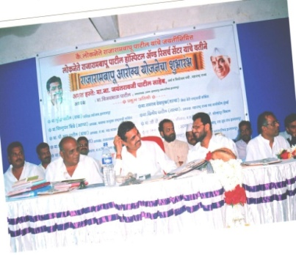
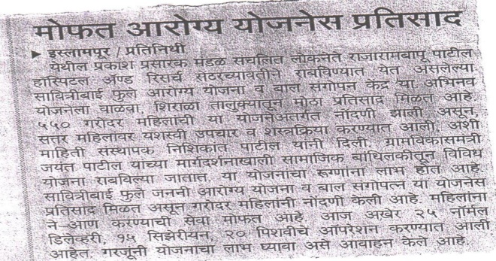
Prakash Shikshan Prasarak Mandal’s
Late Rajarambapu Ayurvedic Medical College, Hospital and Research Center,
Urun Islampur,
Tal.: Walawa Dist.: Sangli.
SR. No. | Date | Social Work | Photocopy of Social Work | Social Work display in Local News Paper time to time
10 | 01/12/12 | Free health checkup scheme and treated various diseases

Slide 11
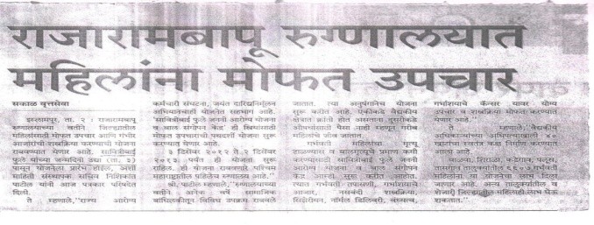
Prakash Shikshan Prasarak Mandal’s
Late Rajarambapu Ayurvedic Medical College, Hospital and Research Center,
Urun Islampur,
Tal.: Walawa Dist.: Sangli.
SR. No. | Date | Social Work | Photocopy of Social Work | Social Work display in Local News Paper time to time
11 | 01/12/12 | Free health check up scheme

Slide 12
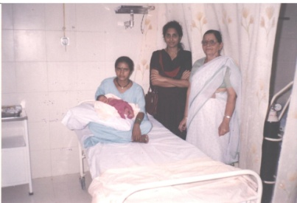
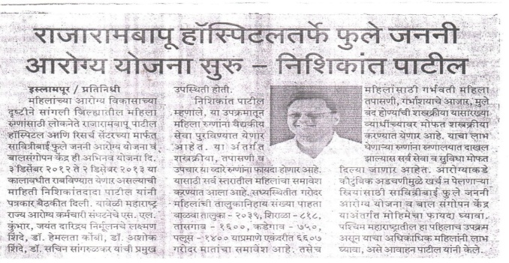
Prakash Shikshan Prasarak Mandal’s
Late Rajarambapu Ayurvedic Medical College, Hospital and Research Center,
Urun Islampur,
Tal.: Walawa Dist.: Sangli.
SR. No. | Date | Social Work | Photocopy of Social Work | Social Work display in Local News Paper time to time
12 | 03/12/12 | Savitribai Fule Janani Yojana

Slide 13
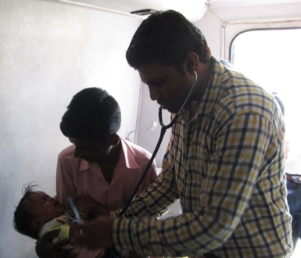
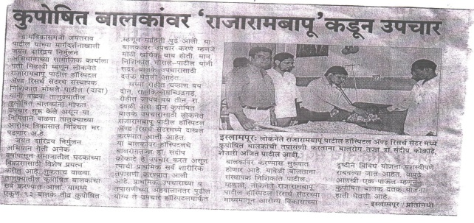
Prakash Shikshan Prasarak Mandal’s
Late Rajarambapu Ayurvedic Medical College, Hospital and Research Center,
Urun Islampur,
Tal.: Walawa Dist.: Sangli.
SR. No. | Date | Social Work | Photocopy of Social Work | Social Work display in Local News Paper time to time
13 | 19/12/2012 | Free Health Camp

Slide 14
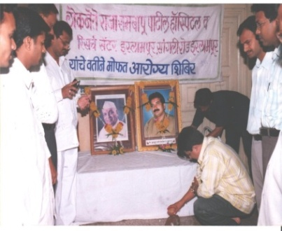
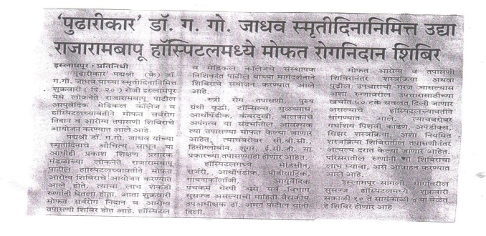
Prakash Shikshan Prasarak Mandal’s
Late Rajarambapu Ayurvedic Medical College, Hospital and Research Center,
Urun Islampur,
Tal.: Walawa Dist.: Sangli.
SR. No. | Date | Social Work | Photocopy of Social Work | Social Work display in Local News Paper time to time
14 | 19/01/2013 | Free Health Camp

Slide 15
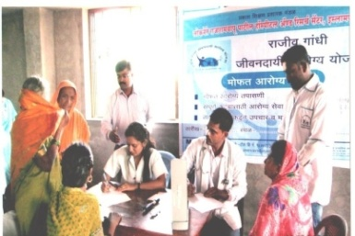
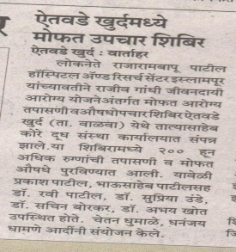
Prakash Shikshan Prasarak Mandal’s
Late Rajarambapu Ayurvedic Medical College, Hospital and Research Center,
Urun Islampur,
Tal.: Walawa Dist.: Sangli.
SR. No. | Date | Social Work | Photocopy of Social Work | Social Work display in Local News Paper time to time
15 | 09/01/2014 | Free medical Aid Program under RGDAY Health Camp in Rural area

